Slide 1



Shifting Crude Oil Quality and Refining Constraints:
A Data-Driven Analysis of Global Heavy Oil Dependence
and Market Disruption Risk
Andrew Gellner, Michael Morgan, Yu Ling Wong
Industry Capstone Symposium
12 August 2026
Notes:
Welcome everyone to our project presentation Analyzing Crude Oil Quality and Global Heavy Oil Dependence and Modeling Market Disruption Risk, done in collaboration with our industry partner Chirality Research.

Slide 2
Contents
Introduction & Background
01
02
The Problem
03
The Solution
Methodology
04
05
Results and Analysis
Limitations and Next Steps
06
Notes:
Over the course of this presentation, we will introduce our research problem and some background knowledge. We will introduce our solution and our methodology. We will review our high-level results and analysis, and finally mention our limitations and next steps.

Slide 3
Introduction & Background
Global Crude Oil Market
API Gravity (Light vs. Heavy)
Sulfur Content (Sweet vs. Sour)
Canada’s Oil Deposits
Heavy Crude Oil
Bitumen Oil Sands
Heavy Crude Oil Uses
Marine Fuel
Bunker Oil
Heavy Distillates
Production Risks
More expensive and complex to refine
Geopolitical Disruptions (Wars, Sanctions)
Notes:
Now to give some background information. The global crude oil market can be differentiated based on two factors, API Gravity and Sulfur Content. API Gravity is the most relevant factor for our research problem, specifically we’re looking at heavy crude oil. Heavy crude oil constitutes a large portion of Canada’s oil deposits, along with bitumen oil sands, which is also considered heavy for our purposes. Heavy crude oil may fly under the radar, but some pretty important products can be produced from it, such as marine fuel, bunker oil, and heavy distillates. There are also a number of production risks that cause vulnerability. Specific to heavy crude, it is more expensive and complex to refine, which reflects in discounted market prices. Additionally, oil producing countries such as Canada may be vulnerable to geopolitical disruptions such as wars or sanctions.

Slide 4
Event Scenarios for Modeling
✔ Geopolitical Conflicts
1973-1974 OPEC Embargo
Iran-Iraq War (1980-1988)
Gulf War (1990-1991)
Iraq War (initial disruption; 2003)
✔ Localized Disruptions
Iranian Revolution (1978-1979)
Venezuelan General Strike (2002-2003)
Hurricane Katrina (2005)
Fort McMurray Wildfires (2016)
✔ Sanctions on Oil Producers
Iraq Gulf War Sanctions (1991-1996)
US Sanctions on Venezuela (2017-)
G7 Oil Price Cap on Russia (2022-)
Enbridge Pipelines (Line 3, Line 6,
Express, Alberta Clipper)
Keystone Pipeline
Trans-Mountain Pipeline
✔ New Pipeline Construction
Notes:
Now to briefly touch on the topic of production risks, we will look at some of the event scenarios we used in our modeling. The events can be divided into 4 categories, Geopolitical Conflicts, which includes wars involving oil producers as well as OPEC embargos. Localized Disruptions, which run the gamut from the Iranian Revolution and the Venezuelan General Strike to the Fort McMurray Wildfires, but is in all cases concentrated within one area. Sanctions on Oil producers, the main topic of which we’re looking at is US sanctions on Venezuela. And finally, New Pipeline Construction from Alberta to export markets. All of these events have different effects, but are similarly important to understanding how heavy crude oil production can be affected.

Slide 5
The Problem
How has the global mix of heavy crude changed over time?
Which countries produce and consume heavy oil, and how has this changed across historical disruptions?
How concentrated is global heavy crude production?
Which countries are structurally dependent on heavy crude?
What strategic role could Canada play in mitigating future heavy crude shortages?
Notes:
Now to introduce our research problems, we looked at 5 questions in particular…
How has the global mix of heavy crude changed over time?
Which countries produce and consume heavy oil, and how has this changed across historical disruptions?
How concentrated is global heavy crude production?
Which countries are structurally dependent on heavy crude?
And what strategic role could Canada play in mitigating future heavy crude shortages?
Now I’ll turn it over to Michael.

Slide 6
The Solution
Collect and engineer data
Forecast
Scenario analysis
Assess risk
Notes:
To answer the research questions, we employed a handful of data science and analytics tools to conduct an analysis on oil production, consumption, and trade for each of the countries we analyzed.
And our high-level workflow was like this: first, we collected and engineered data, then conducted time series forecasting, analyzed scenarios, and finally assessed risk using an index.

Slide 7


Research and Data Sources
✔ Total Crude Production
and Consumption
✔ Country-level drilldown
News articles
Press releases
Journals
✔ Disruption Events
EIA
Academic papers
✔ Canada’s trade partners
Canadian International Merchandise Trade Web Application
Notes:
We used data from the EIA, which is the U.S. Energy Information Administration, for total oil production and consumption for most countries worldwide. It doesn’t include heavy crude data, so we had to estimate these numbers ourselves.
To do that we conducted research on specific oil basins and extraction in individual countries, using news articles, government press releases, and scholarly journals.
We also researched historical events that disrupted the production and consumption of oil within the past 50 years using EIA data and academic papers, to determine the duration and types of these events.
And finally we researched Canada’s oil trade partners using the Government of Canada’s ‘Canadian International Merchandise Trade Web Application’.

Slide 8


The Deliverables
✔ Automated Data Pipeline
✔ Reproducible Script Library
✔ Interactive Dashboard
✔ Forecasts and Scenario Analysis
✔ Risk Index
Notes:
So what are we delivering to our industry partner?
Aside from our heavy crude estimates and research into historic disruption events,
We created an automated data pipeline and reproducible code library, within Databricks, using Python, SQL, and Spark.
We made an interactive dashboard with Power BI, that gathers together the analyses and forecasts we created this summer.
These forecasts are statistical time-series forecasts, a topic we learned briefly in our coursework this past year, but did not get opportunities to expand on until now.
And finally we’re delivering an index that quantifies a scenario’s risk to Canada’s oil industry.

Slide 9
Methodology
Heavy crude estimate
Time series forecasting
Risk Index
Notes:
Let’s take a high level look at how we created our
Heavy crude estimation
Time series forecasts
And risk index

Slide 10
Heavy Crude Estimation
Total crude
We used multiple sources to arrive at a best estimate for how much of a country’s industry involved extracting heavy crude
x % heavy crude
= Heavy crude estimate
Notes:
As mentioned earlier, we had a source of total oil production for each country, but this project is interested in heavy oil. Unfortunately, data on production by oil gravity is not readily available for most countries, so we had to estimate it.
We researched each selected country’s oil industry, from the composition of their reserves to what is extracted.
and we arrived at a percentage per year of how much of a country’s oil industry was extracting heavy crude.
We then multiplied that percentage by the total crude number to arrive at an estimate for heavy crude production per year.

Slide 11
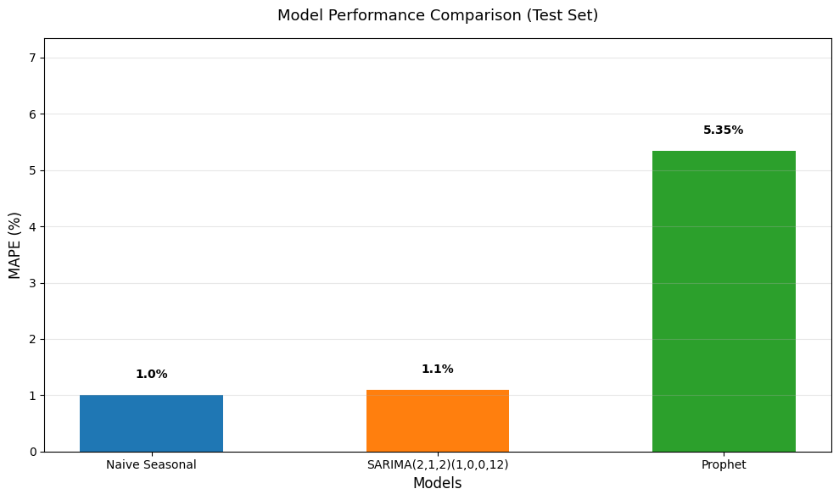
Time Series Forecasting
“Baseline” Modelling
The forecast models | ARIMA, SARIMA, Prophet
The forecast horizon | 5 years
The methodology | grid search, AIC, MAPE
Notes:
Now, let’s take a high level look at how we produced our time series forecasts.
We used the statistical models ARIMA and SARIMA, and the machine learning model Prophet to produce forecasts for each country’s heavy crude production and consumption, with a forecast horizon 5 years into the future.
Parameters for ARIMA and SARIMA were optimized using a grid search function, utilizing AIC as the metric.
The best models were selected automatically in our python script, by minimizing Mean Absolute Percentage Error.

Slide 12
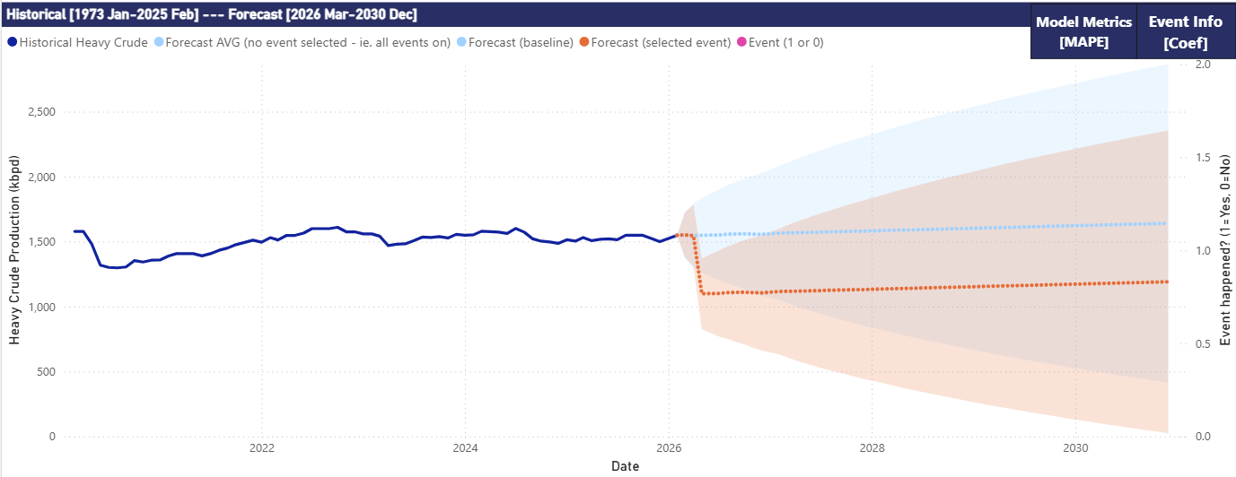
Time Series Forecasting
“Scenario” Modelling
Binary exogenous variables to model each scenario
Compare baseline country forecasts to scenarios
Notes:
In addition to one baseline forecast for each Country, we produced forecasts for 29 other scenarios by adding exogenous, or external variables, for historical disruption events.
And this variable is binary. It’s set to 0 during the periods when the event is NOT occurring and 1 when it is. Then, when modelling the forecast for a scenario, the exogenous variable is set to 1 in future years to create a forecast that is influenced by the event it’s based on.
After modelling these scenarios, we could then compare a country’s baseline forecast to the scenario forecast, which we’ll see in the dashboard in a few moments.

Slide 13


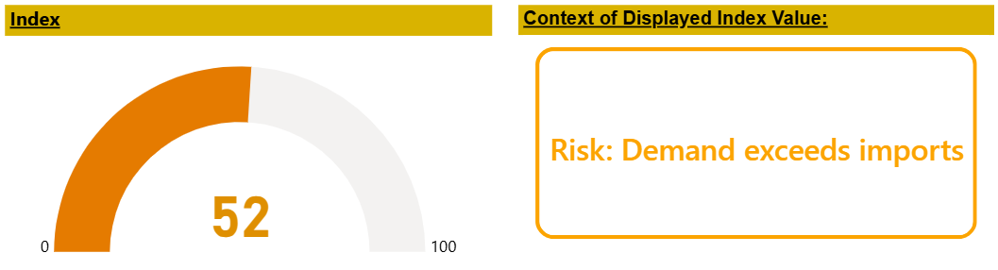
Canada Risk Index
Canada’s Risk Index
Shock
x Exposure
= Risk Index
Notes:
But before that, we have one more methodology to mention, and that is the creation of the Risk Index, which is an indicator from 1 to 100 of a scenario’s risk to Canada’s current oil trade.
And to do this, we created two metrics, shock and exposure.
Shock represents the magnitude of the historical event.
Whereas exposure represents Canada’s trade relationship to the country where the event occurs.
Multiplied together we get the Risk Index that indicates the level of risk to Canada’s oil industry for each scenario.
In the example scenario pictured here, the Index is 52 out of 100, with Canada’s demand outpacing imports due to an event that impacted a trade partner’s production.
Now I’ll turn it over to Elaine to present our dashboard and results.

Slide 14
Results and Analysis
How has the global mix of heavy crude changed over time?
Which countries produce and consume heavy oil, and how has this changed across historical disruptions?
How concentrated is global heavy crude production?
Which countries are structurally dependent on heavy crude?
What strategic role could Canada play in mitigating future heavy crude shortages?
Notes:
(Elaine)
Thank you Michael. Now that we’ve walked through our methodology, we’ll use some parts of the Power BI dashboard we’ve created to answer our research questions. (NEXT SLIDE)
To answer our first research question, How the global mix of heavy crude has changed over time, we’ll look at the Monthly Heavy vs Total Crude Production view. (NEXT SLIDE)

Slide 15
Results and Analysis
How has the global mix of heavy crude changed over time?
Which countries produce and consume heavy oil, and how has this changed across historical disruptions?
How concentrated is global heavy crude production?
Which countries are structurally dependent on heavy crude?
What strategic role could Canada play in mitigating future heavy crude shortages?
Notes:
Now that we’ve walked through our methodology, we’ll use some parts of the Power BI dashboard we’ve created to answer our research questions. To answer our first research question, How the global mix of heavy crude has changed over time, we’ll look at the Monthly Heavy vs Total Crude Production chart.

Slide 16
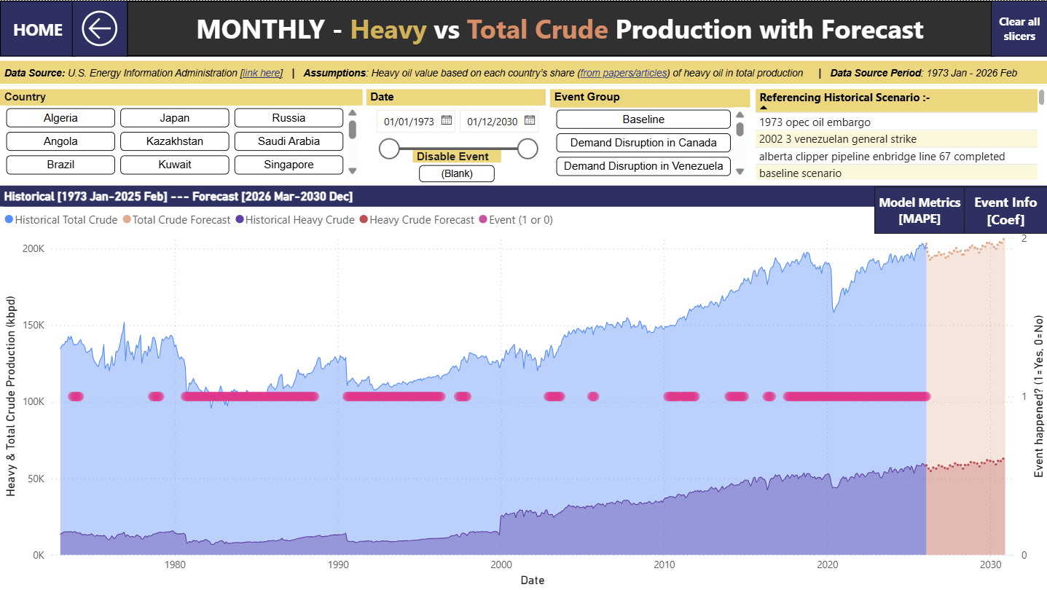
Notes:
This chart shows both the historical and forecasted production from 1973 to 2030. The light blue area represents total crude, and the darker purple area represents heavy crude. What we can see immediately is that total crude has grown steadily over the past five decades, while heavy crude has grown at a slower pace. Heavy crude remains a relatively small share of global production, and although that share has increased over time,

Slide 17
Notes:
it’s been fairly stable in the last decade.

Slide 18
Notes:
Looking ahead in the forecast, which is in the orange zone, shows the same pattern. Total crude is projected to keep climbing, while heavy crude grows more gradually, suggesting the global mix will remain dominated by lighter crude. This has real implications for refining capacity and for countries like Canada, that rely heavily on heavy‑crude markets.

Slide 19
Results and Analysis
How has the global mix of heavy crude changed over time?
Which countries produce and consume heavy oil, and how has this changed across historical disruptions?
How concentrated is global heavy crude production?
Which countries are structurally dependent on heavy crude?
What strategic role could Canada play in mitigating future heavy crude shortages?
Notes:
To answer our second and third research question, which countries produce and consume heavy oil, and how has this changed across historical disruptions and How concentrated is global heavy crude production?, we’ll look at the Heavy Crude Consumption and Production with Country ranks dashboard.

Slide 20
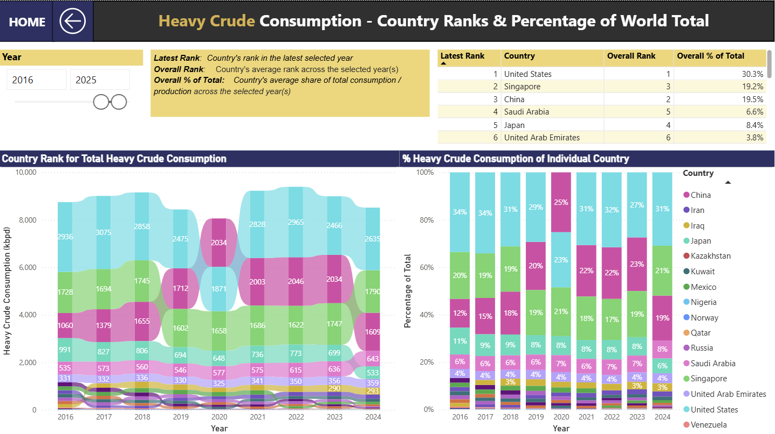
Notes:
On the consumption side

Slide 21
Notes:
the United States, China, and Singapore consistently make up the largest shares of global consumption.

Slide 22
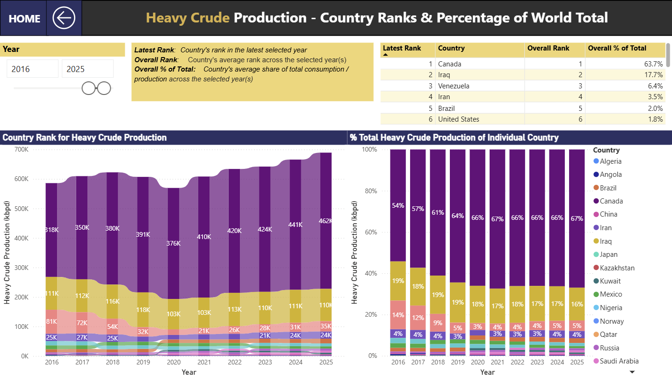
Notes:
On the production side, the picture is even more concentrated.

Slide 23
Notes:
Canada is by far the dominant producer of heavy crude, accounting for more than half of global supply and increasing its share over time.

Slide 24

Notes:
Iraq and Venezuela follow, but their production is much more sensitive to disruptions. Here I’ll show an example of what I mean

Slide 25
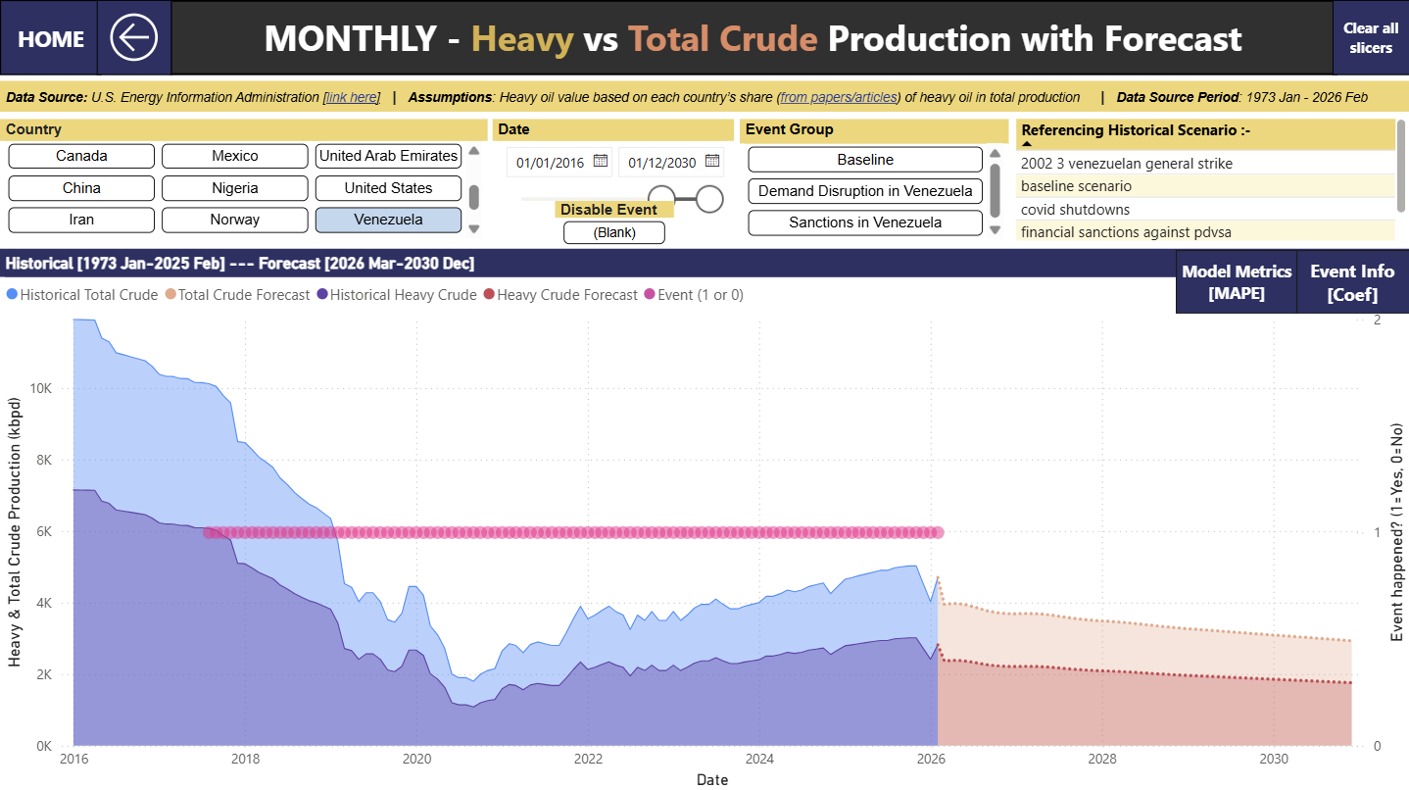
Notes:
Over here we can see that Venezuela’s share drops sharply

Slide 26
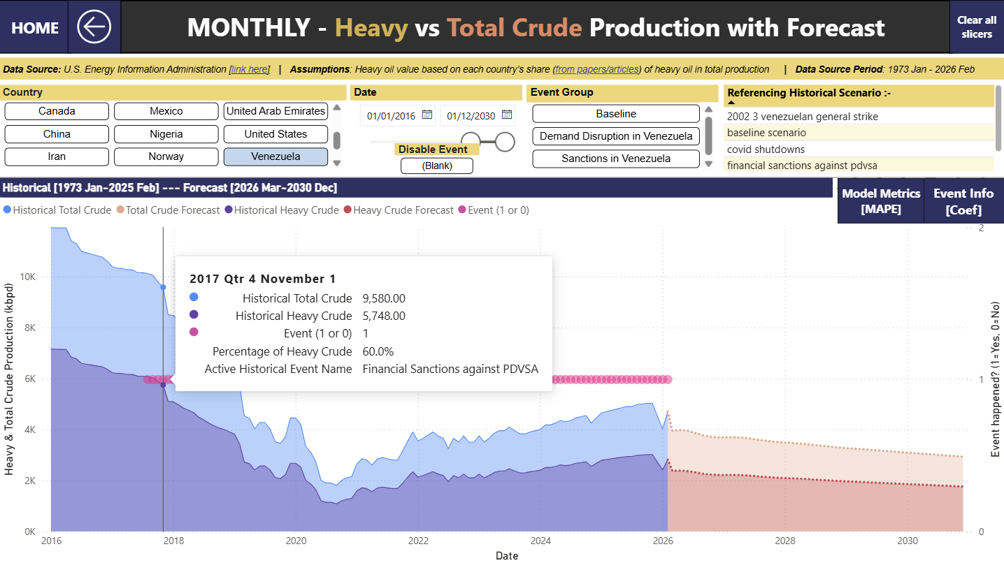
Notes:
during political and economic crises, starting around 2017/2018,

Slide 27
Notes:
While within the same timeframe…

Slide 28
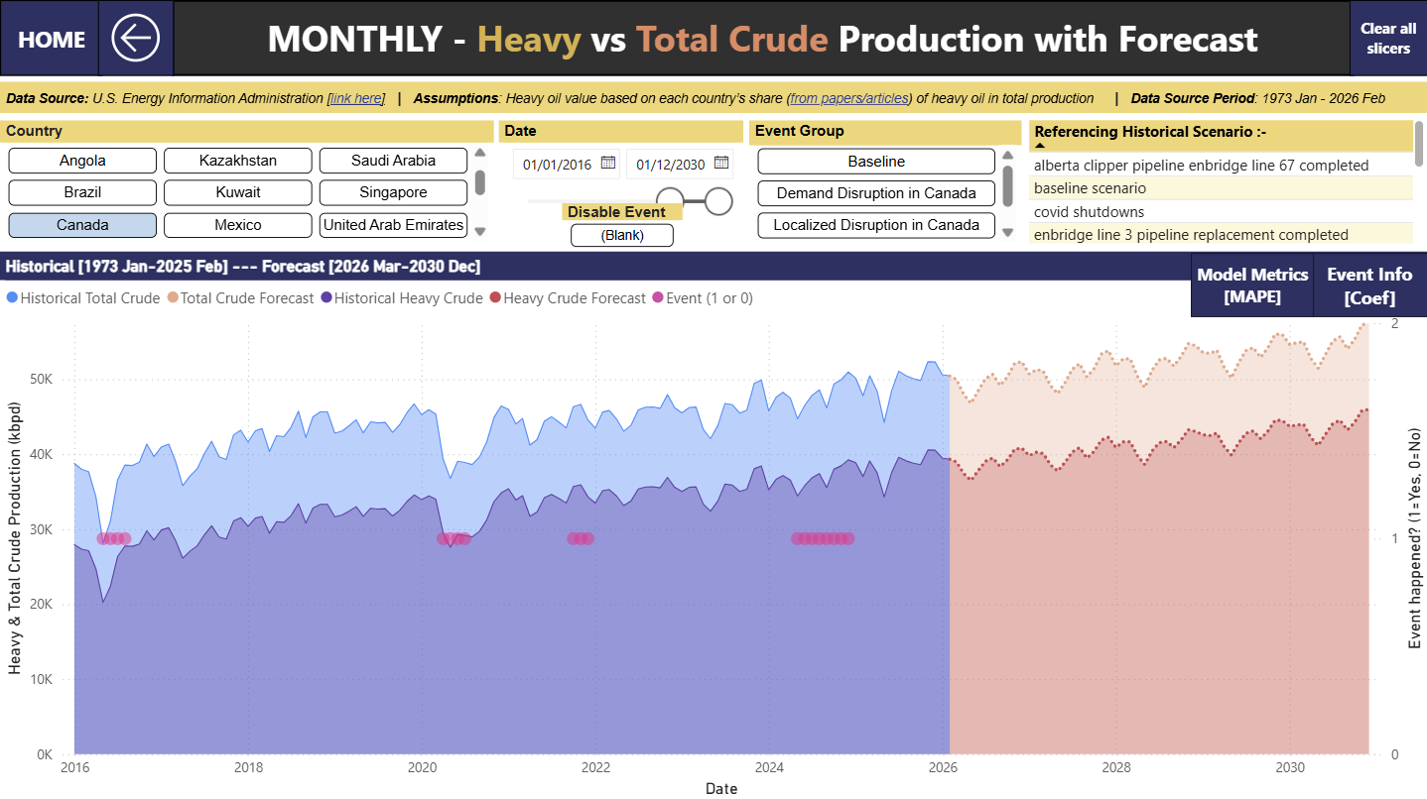
Notes:
Canada’s production remains steady or continues to grow.

Slide 29
Notes:
Here let’s refer back to the heavy-crude production percentage‑share chart to answer our 3rd research question. The pattern here is very obvious. Canada stands out as the central player, while most other countries contribute only marginal amounts.
All in all, we can say that global heavy‑crude production is highly concentrated among just a few producers, with Canada shaping the market more than anyone else.

Slide 30
Results and Analysis
How has the global mix of heavy crude changed over time?
Which countries produce and consume heavy oil, and how has this changed across historical disruptions?
How concentrated is global heavy crude production?
Which countries are structurally dependent on heavy crude?
What strategic role could Canada play in mitigating future heavy crude shortages?
Notes:
For our fourth research question, which countries are structurally dependent on heavy crude?, the Net Balance data gives us a clear picture of who the major heavy crude producer and consumers are.

Slide 31
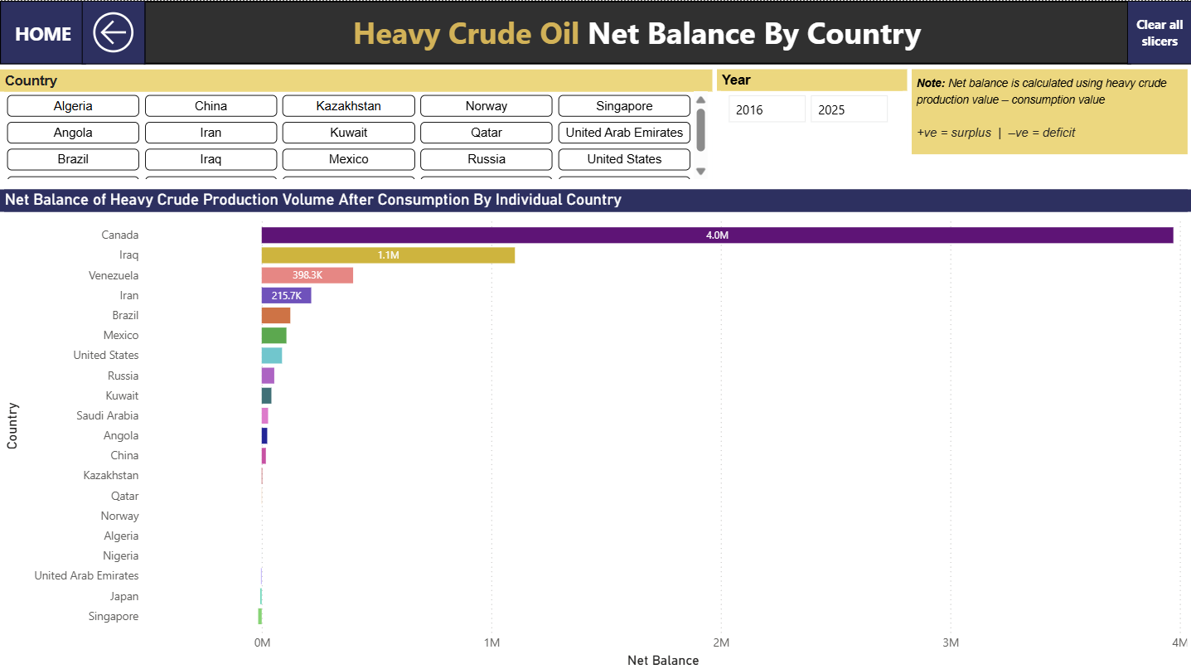
Notes:
Countries with large positive balances,

Slide 32
Notes:
like Canada, Iraq, and Venezuela, produce far more heavy crude than they consume. On the other hand, countries like

Slide 33
Notes:
Singapore and Japan consume much more

Slide 34
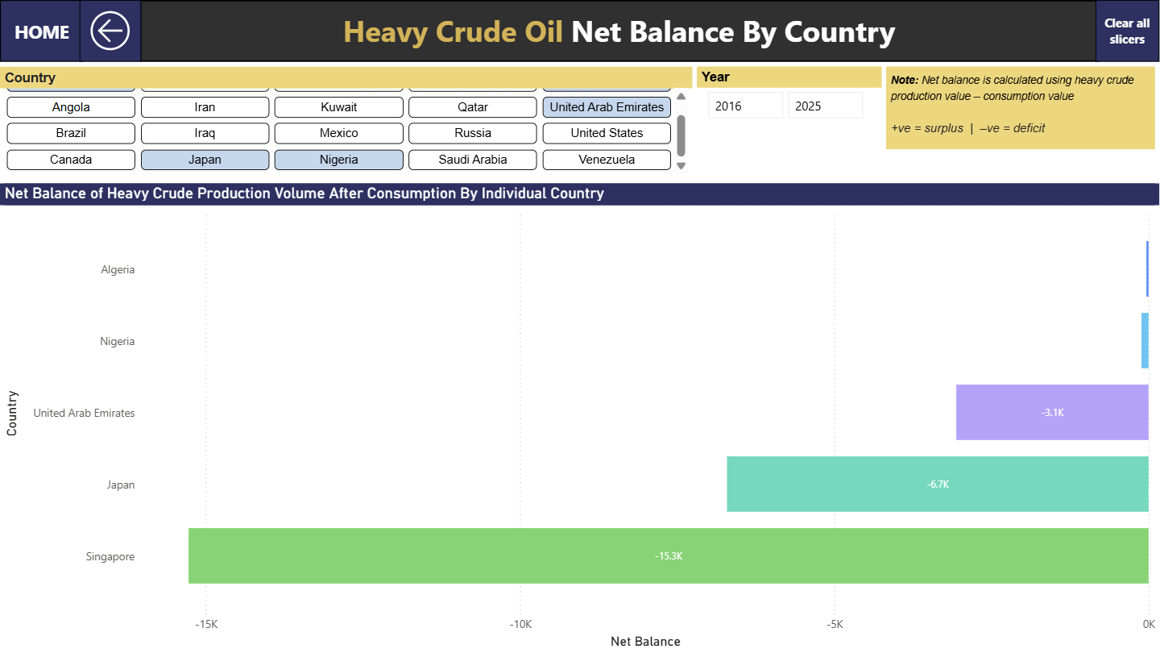
Notes:
heavy crude than they produce, meaning they rely heavily on imports for their demand.

Slide 35
Notes:
So structurally we can say that, Canada, Iraq, and Venezuela are dependent as producers, while Singapore, and Japan are dependent as consumers.

Slide 36
Results and Analysis
How has the global mix of heavy crude changed over time?
Which countries produce and consume heavy oil, and how has this changed across historical disruptions?
How concentrated is global heavy crude production?
Which countries are structurally dependent on heavy crude?
What strategic role could Canada play in mitigating future heavy crude shortages?
Notes:
To answer our final research question, what strategic role Canada could play in mitigating future heavy‑crude shortages, we can go back to the Net Balance dashboard I’ve shown just now.

Slide 37
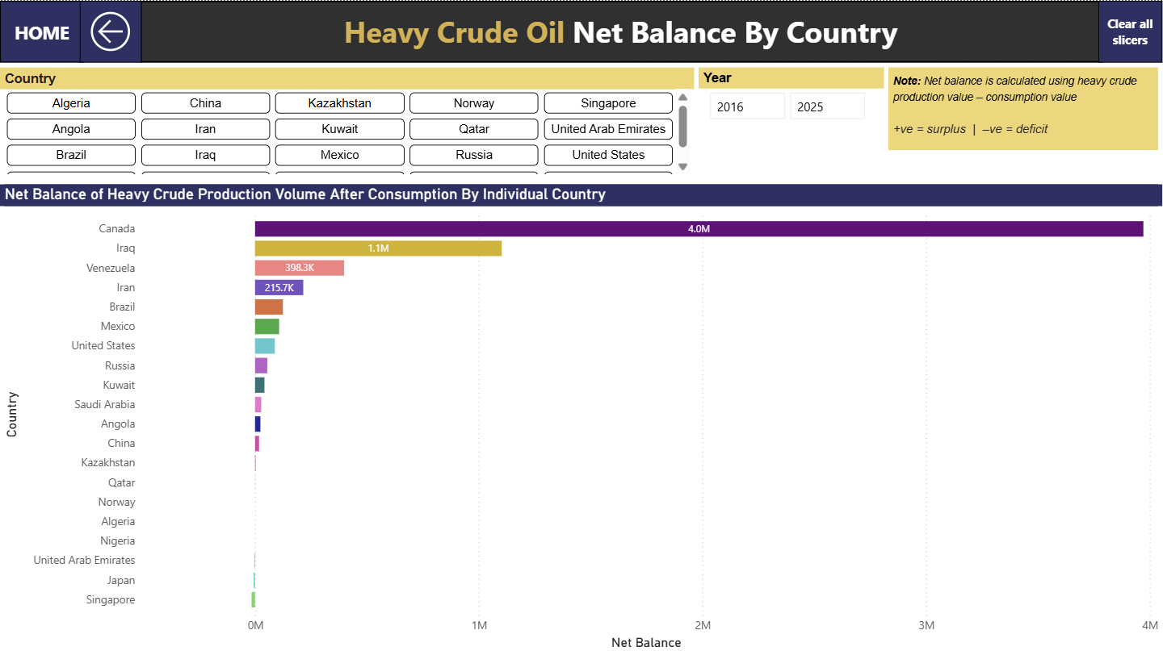
Notes:
Canada produces far more heavy crude than it consumes, which means we have a really high surplus to work with.
So the natural question becomes: what can Canada actually do with that surplus? To answer that, we need to look at Canada’s heavy‑crude trade relationships, who we export to, how dependent those partners are, and what opportunities that creates. Let’s take a closer look.

Slide 38
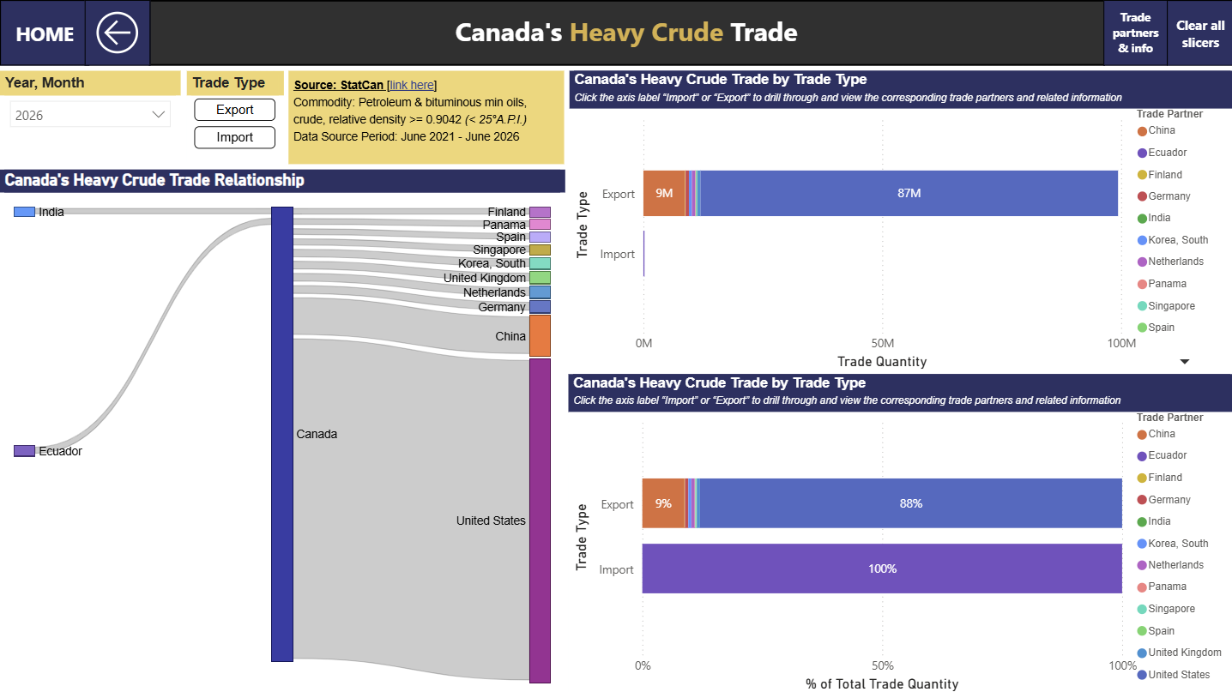
Notes:
Here shows current year’s data for Canada’s heavy crude trade

Slide 39
Notes:
As we can see over here, we trade heavily with the US, approximately 88% of our heavy crude exports go directly to the US, with the remaining volumes spread across a few other countries.
One thing to note is that there are actually other heavy-oil consumers, for example Japan, where Canada currently has little to no trade with at all,

Slide 40
Notes:
as we can see they are not found in the list here.
This actually represents a real opportunity here. By expanding our heavy‑crude partnerships to countries that depend on imports, Canada could position itself as a reliable, stabilizing supplier whenever global shortages or disruptions occur.

Slide 41
Results and Analysis
How has the global mix of heavy crude changed over time?
Which countries produce and consume heavy oil, and how has this changed across historical disruptions?
How concentrated is global heavy crude production?
Which countries are structurally dependent on heavy crude?
What strategic role could Canada play in mitigating future heavy crude shortages?
Notes:
Overall, the dashboard we’ve built is fully capable of answering all of our research questions, and what’s even better is that it actually reveals insights far beyond this, which you'll be able to explore through the interactive dashboard, but that’s a deeper dive we’ll save for another day.
Next we’ll walk through some of our project limitations and potential next steps.

Slide 42
Limitations and Next Steps
Improve heavy crude estimates
Improve our country-level heavy crude production assumptions or use a proxy for heavy crude production.
Improve heavy crude forecasting
Targeted research into expected heavy crude production in a given country
Inclusion of additional exogenous variables
More external variables, such as commodity prices/futures, could improve forecast accuracy.
Further model optimization
Conduct optimization of Prophet parameters. Try different training and validation sets and test different lags for external variables.
Notes:
Over the 12 weeks we’ve spent working on this project, we’ve made significant progress, achieved many of our objectives, and established a strong foundation for future work.
From that work, we’ve identified a few key areas to focus on next.
First we can look into improving either our country-level heavy-crude production assumptions, or we could use a more reliable proxy for heavy-crude production when direct data isn’t available.
We can dive deeper into the research of the expected heavy-crude production in a given country, especially where new extraction infrastructure might come online. This gives us a more realistic outlook than just simply extending past trends, which is what we had to rely on for some countries in this project.
We can also look into adding more external variables, like commodity prices, which could meaningfully improve our forecast accuracy and give us a better sense of how heavy‑crude production and consumption responds to broader market conditions.
There’s also room to optimize our Prophet models by experimenting with different parameter settings, training windows, and lag structures. Which would potentially help us better capture the dynamics of heavy‑crude trends.
This concludes our presentation. Thank you all for your time and attention!
Beyond forecasting, we can also map out the broader network of global oil trade to capture indirect disruptions that could affect Canada and quantify how it effects the world as a whole.
And finally, there may be additional indicators worth incorporating into our Risk Index as we refine it further.

